Slide 1
Digitalization of QC Story

Slide 2
Problem Statement

Slide 3
Project Objective
Digitalize
Digitalize QC Story Workbook
Track
Track Actions & Closures
Improve
Improve Review Efficiency
Generate
Generate Digital Reports

Slide 4
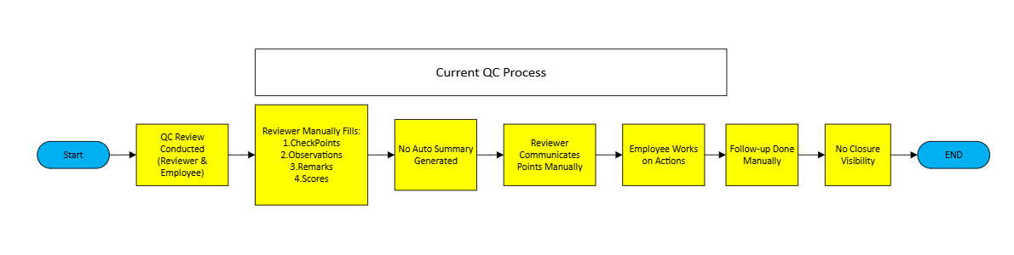

Slide 5
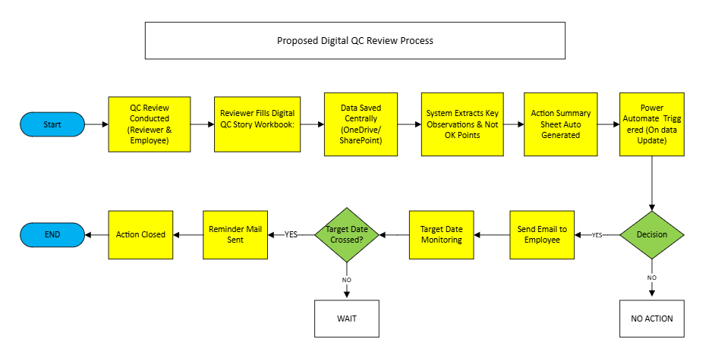

Slide 6
Digitalization Approaches
Excel + Automation Integration
Content Scanning & Digital Review Analyzer
Digital QC Story Portal

Slide 7
Approach1 : Excel + Automation Integration
Current QC Story Workbook
Structured Action Sheet
Extract Action Points
Assign Responsible Person
Send Auto Mail Notifications
Track Target Dates
Send Reminder Alerts
Closure Updated
Outcome(Automated Action Tracking)

Slide 8
Approach2 : QC Story Content Review Analyzer
QC Story Workbook
Upload / Input to System
System scans all sheets
Reads written content
Identifies Missing Analysis / Actions
Highlights weak Areas
Generates Review Summary
Outcome(Content Based Gap Identification)

Slide 9
Approach3 :Digital QC Story Portal
User logs into Portal
Create / Select Project
Fill stage wise Digital Forms
Data stored Centrally
System generates QC Story Report
Extract Action Items
Assign to Owners
Send Notifications
Outcome(End-to-End Digital QC Story System)

Slide 10
Comparison of Digitalization Approaches
Criteria | Excel + Automation | Content Analyzer | Digital Portal
Implementation Method | Automated Workflows | Content Scanning System | Portal-based Entry
Technology Stack | Excel + Power Automate | Python + NLP | Power Apps / Web
Automation Level | Medium | High | Very High
Visibility of Pending Points | Automated Tracking | Intelligent Detection | Real-time dashboard
Scalability | Moderate | High | Very High

Slide 11
Thank You

